Slide 1
Query Processor Compilation
Distributed Normal Form and Query compilation architecture

Slide 2
Classic Garlic-style Query Compilation Architecture

Slide 3
Classic Garlic-style Query Compilation Architecture
Source wrappers :
contiguous sub plan vs
pull down.
(Exhaustive) Search Space:
STARs vs
Plan Graph
Optimization :
Staged
Holistic
Delegation :
search space for source
delegating to source (super node from Fall)
Rewrite Rules Paradigms:
Greedy/Heuristic
Exhaustive
Cost Model :
How to normalize across sources
How to get cost for each source
Rewrite Rule Classes :
Join ordering
Pushing selections
Apply-plan Removal
Eager Lazy Aggregation
Semijoin-Reduction

Slide 4
Normal Forms
In order to construct a Distributed Normal Form (DNF), we first need to build normal forms for each source we want to support :
SQL
MongoDB
Jaql
Hive

Slide 5
SQL Normal Form
Three Dimensions :
Operators : See next slides.
Data model : Data models are not inter-compatible across data sources. For instance, SQL data cannot contain nested collections. We can, however, “hide” nested collection information inside SQL (by having a JSON string inside a text attribute, for example). Nevertheless, we cannot do processing on such hidden nested collection. Moreover, it is not known how difficult it is to manage such unprocessable entities within the SQL processing pipeline. We represent this limitation using policies :
NO NESTED policy : the data source is not allowed to process data that may contain nested collection attributes.
IGNORE NESTED policy : the data source is allowed to process data that may contain nested collection attributes. However, it may not process any operator which attempts to navigate within these attributes.
Configuration : Our source normal form does not consider the source requirements of the configuration of operators. This will be introduced in the future.

Slide 6

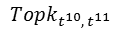
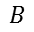
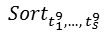
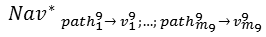
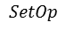

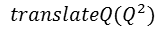
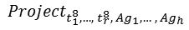
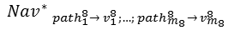
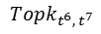
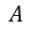
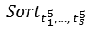
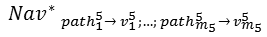

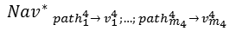

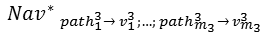

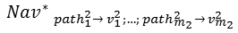

translateQ(Q)
Q
Requirements
Policies :
[IGNORE NESTED] : Tuples containing flat and nested attributes are allowed to be processed by SQL data source.
[NO NESTED] : Only tuples containing flat attributes are allowed to be processed by SQL data source.
ADVICE TO THE READER : Detail knowledge of operators in the normal form is not required to understand the argument that follows.

Slide 8
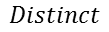
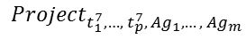
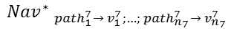
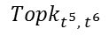
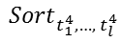
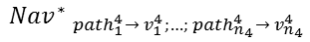
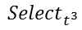
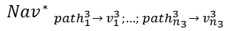

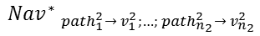
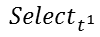
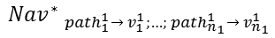
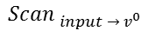
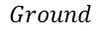
translateQ(Q)
Q
Requirements
: Size of output of query restricted to 16MB, and single operator cannot use more than 10% of system RAM
SELECT DISTINCT
t₁⁷,
…,
t_{p}⁷
f₁^{A} (t_{1,1}²,…, t_{1,k1}²) AS Ag₁,
…,
f_{m}^{A} (t_{m,1}²,…, t_{m,km}²) AS Ag_{m}
FROM
input
WHERE
t¹
GROUP BY
t₁², …, t_{k}²
HAVING
t³
ORDER BY
t₁⁴, …, t_{l}⁴
LIMIT
t⁵
OFFSET
t⁶
Slide not updated for data model. Incomplete

Slide 9
Decoupling dimensions
We should decouple the two questions :
Does a DNF exist?
Can we motivate an operator pull down performed by source wrappers on a plan that conforms to a DNF?
Obviously, we cannot achieve 2) without achieving 1). My first objective is to find out if a normal form exists, assuming wrappers can only build contiguous sub plans for distribution.
Criteria for existence of a unique DNF :
There exists a query Q such that there are no generic (source unaware) plan PQ that can be efficient for all of the underlying sources of the DNF.

Slide 10
DNF cannot exist : Example
We show by example that a DNF cannot exist IF the SQL source normal form chosen follows NO NESTED semantics (see slide 5).
Assume following schema on two data sources (PostgreSQL and MongoDB) :
Postgres.order = [id, country, date]
Postges.item = [id, order_id, product_id]
Mongodb.product = [id, name, categories*={category}, available={country}*, price]
Where :
Underlined attributes are the primary key.
Order_id is a foreign key referencing order.id
Product_id is a foreign key referencing product.id
Attributes annotated with (*) are nested tables, themselves with their own schema shown within the “={}”

Slide 11
Example SQL++ Queries
1) Get all the legal orders for ‘puppets’ since 01/01/2014 (an order is legal if all items contained in that order are available in the country of purchase).
SELECT order_id
FROM postgres.order AS O,
Postgres.item AS I,
Mongodb.product AS P
WHERE O.id = I.order_id AND
I.product_id = P.id AND
‘puppets’ IN P.categories AND
O.date > 01/01/2014 AND
O.country IN P.available
2) Get all orders for ‘puppets’ with price greater than 50$
SELECT order_id, SUM(P.price) AS price
FROM postgres.order AS O,
postgres.item AS I,
mongodb.product AS P
WHERE O.id = I.order_id AND
I.product_id = P.id AND
‘puppets’ IN P.categories
GROUP BY order_id
HAVING price > 50

Slide 12
Query Plan Strategies
Query 1 has a complexity arising from the heterogeneity of the data model in the following condition of the WHERE clause:
O.country IN P.available
There are two query strategies to answer queries of the type (assume previously stated schema) :
SELECT O.order_id
FROM Order AS O, Product AS P
WHERE O.country IN P.available
The two techniques are described next.

Slide 13
Query Plan Strategies Join Technique
The join technique would simply compute the join of the two relations and apply the selection later on.
If the source cannot handle such a selection because of its heterogeneity, it would simply leave its processing to the middleware.

Slide 14
Query Plan Strategies ApplyPlan Semijoin Technique
The apply plan semijoin technique would extract the nested table from the heterogeneous data source and inject it in the homogeneous data source (using the navigate operator). It would then process multiple queries on the homogeneous data source using the nested table attribute as a table by itself. This allows processing of the selection within the homogeneous data source.
Note that we do not consider multiple levels of nesting.

Slide 15
Plans for query 1
A. Join technique
B. Apply Plan Semijoin technique

Slide 16
Best Plan For Query 1
In the distribution phase, the SQL source normal form could use either a NO NESTED policy or IGNORE NESTED policy. We assume NO NESTED policy.
Using NO NESTED semantics, joins cannot be done within Postgres if the joined relations have nested table attributes. Entire tables have to be exported to middleware for further processing. Plan A) becomes very inefficient.
Plan B allows us to unnest data by sending multiple queries Qi to SQL using the ApplyPlan operator. The queries Qi can individually be processed much faster by SQL. This is possible because of the absence of nesting in Qi.
Overall, plan B) is the winner.

Slide 17
Plans for query 2
A. Join technique
B. Apply Plan Semijoin technique

Slide 18
Best Plan For Query 2
Again, we use NO NESTED semantics.
In this query, the NO NESTED semantics don’t matter as much because nested values are projected out early from the normal form. Therefore, join operators in the plan can be done in SQL (because their operands no longer have nested table attributes).
The apply plan operation from plan B becomes overkill because Pi will always only contain a single tuple.
Overall, plan A) is the winner.

Slide 19
Extra Projections
You may have seen in the query plans projections with an asterisk (*). These projections are not part of a DNF but :
They are used to help explain the problems introduced by the heterogeneity of the data model.
They are useful optimizations that should be implemented by source wrappers (source wrappers should project out any information from the tuples it is sending that is not required by the query for further processing).

Slide 20
Results
Assumptions:
We are using NO NESTED policy for the SQL source normal form.
A single DNF cannot generate plan A or plan B given an input query.
Conclusion:
In query 1, plan B is preferred. In query 2, plan A is preferred.
As such, a single DNF for SQL and MongoDB cannot be constructed.

Slide 21
Complaints
Voiced by Kian Win : 2) is not necessarily true. We have access to the schema information from both sources. We know whether an attribute is a nested collection.
Using this information, whenever we see a condition within a query which requires processing of a nested table by SQL (such as “O.country IN P.available”), we could have our DNF generate a plan using the apply-plan semijoin technique, and use a regular join technique otherwise.
My counter-complaint : are you sure it is possible to build a single DNF which could generate both plans? If am not sure how I would go about representing it myself (although I agree that build and representing are two different concerns).
This result only applies if SQL uses a NO NESTED policy. One could easily see why this wouldn’t happen if we use the more permissive IGNORE NESTED policy. Plan A would always be preferred. This raises the question of the difficulty and the risks of using the IGNORE NESTED policy to build the DNF.

